Slide 1

Virtual Environment Control System Through Sensor Network
By
GHMDD Lakshan
(IT/13/241)
Under the Supervision of
Mr. B. Hettige
Mr. D Maithri Ranga Kulasekara
General Sir John Kotelawala Defence University, Sri Lanka

Slide 2
Overview
Introduction
Problem situation
Aim
Other’s works
Hypothesis
Technologies adapted
Methodological Approach
Implementation and Results
Conclusion
References

Slide 3

Introduction
Greenhouses form an important part of the agriculture and horticulture sectors of a country.
They can be used to grow plants under controlled climatic conditions for optimal production.
Automated greenhouse involves the automatic monitoring and controlling of climatic parameters which directly or indirectly govern the plant growth and hence their production.
In order to control the climate factors and environment autonomously ,it is required a computer/software equipment.

Slide 4
Problem
Environment factors like temperature, humidity and light are hard to control manually inside a Greenhouse and there is a need for automated system to do that task.
When Environment behaviors change rapidly, immediately response must be activated. It can’t be done by the manual system.
As well as manual system’s price is very expensive and maintenance isn’t convenient

Slide 5
Solution
Build a virtual environment control system through sensor network to automatically control the environment parameters that rapidly change.

Slide 6
Aim and Objective
The aim of this project is to build efficient and effective automated system to control the environment parameters that change rapidly.

Slide 7
Objective
Build best greenhouse which is equipped with automatic monitoring and controlling system
Constantly monitor and control environmental condition in green house to ensure it at preset temperature light and humidity level.
Minimizes labor costs involved in maintaining a greenhouse
Detect and maintain temperatures
Detect and maintain humidity levels
Detect sunlight and artificial light.

Slide 8
Others Works
Author’s Name | Research | Description
Ibrahim Al-Adwan, Munaf S. N. Al-D | The Use of ZigBee Wireless Network for Monitoring and Controlling Greenhouse Climate | The local stations are used to measure the environmental parameters The communication between the local stations and the central station is achieved via ZigBee wireless modules
Shivasaisomarathi | Design of Greenhouse Control System Using Wireless Sensor Networks | System has advantages of low power consumption, low cost, good robustness, extended flexible .
Teemu Ahonen, Reino Virrankoski and Mohammed Elmusrati | Greenhouse Monitoring with Wireless Sensor Network | Reads candidates’ responses on the OMR Answer Sheet or OMR Form and converts them into electronic data.

Slide 9
Hypothesis
The system will integrate with Arduino technology and Sensor network to capture the environment parameters. Using standalone c# application and android application will control the environment parameters manually and automatically.

Slide 10
Approach
Input
Environment Parameters
Functional Requirements
Facility to automatically control environment condition with in green house allowing any type of plant to be grown.
Facility to capture the environment parameters like temperature, Humidity and light.
This system should minimize labor cost involved in maintaining greenhouse.
Facility to eliminate risk of greenhouse not being maintained at specific environment condition due to the human errors.
Facility to automatically send SMS to the user when environment parameters changes
Facility to controlled manually using android application and the standalone c# application

Slide 11
Technologies adapted
Sensor Network
Microcontroller
C#
Android
Arduino IDE

Slide 12
Sensor Network
Sensor Network (WSN) consisting of small-size wireless sensor nodes equipped with radio and one or several sensors, is an attractive and cost efficient option to build the required measurement system.

Slide 13
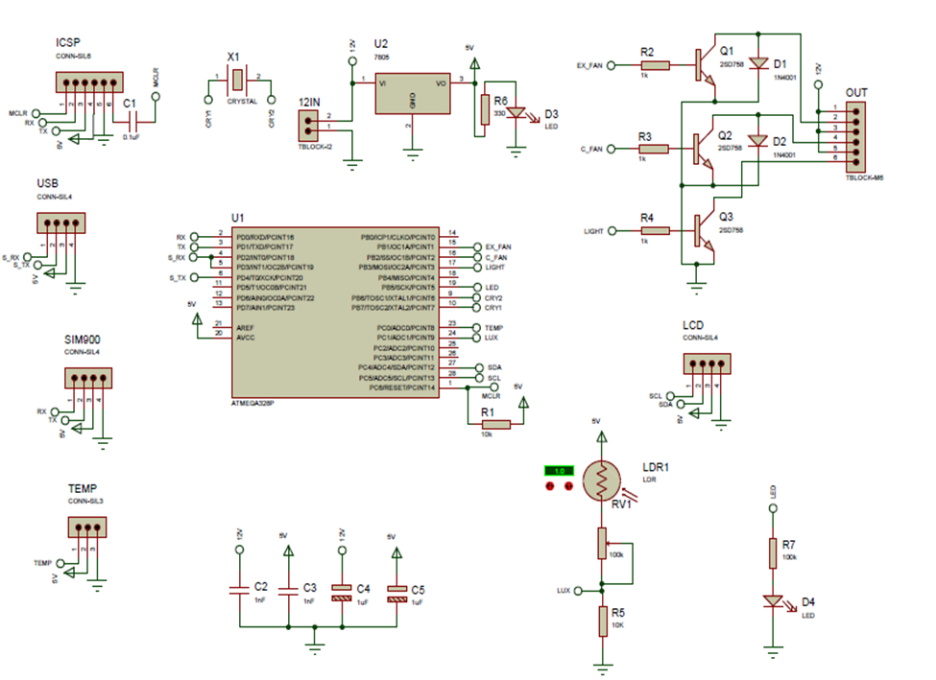
Circuit Diagram

Slide 14


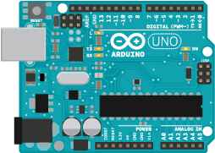


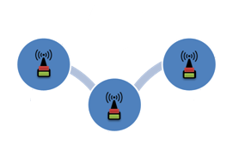



Design
Desktop application
Humidity Sensor
Light Sensor
Temperature Sensor
Sensor Network

Slide 15
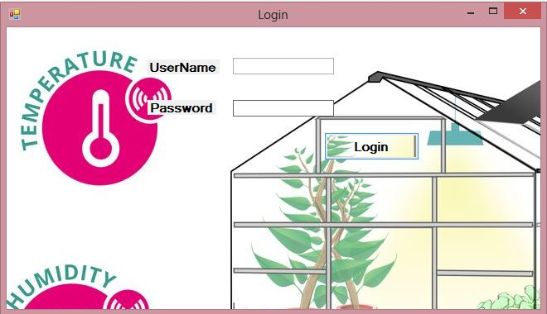
Implementation and Result

Slide 16
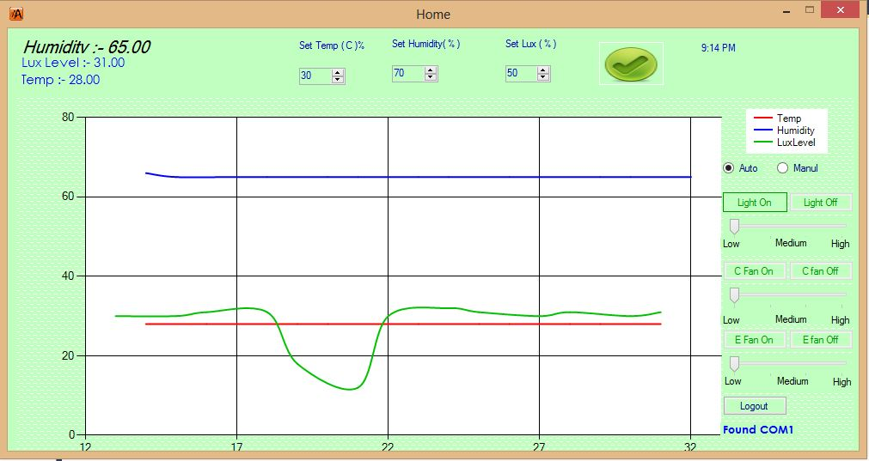
Implementation and Result

Slide 17
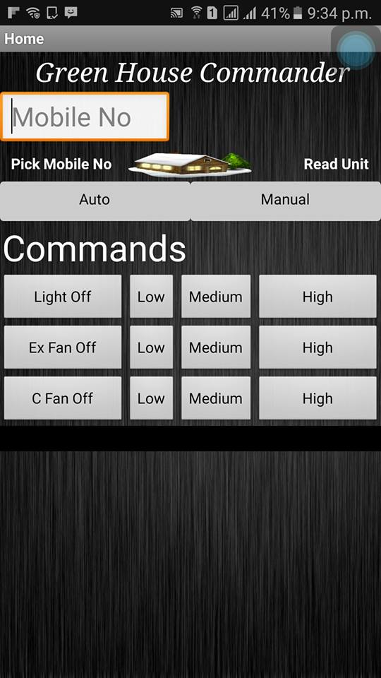
Implementation and Results

Slide 18
Conclusion
In this work, a design and implementation of greenhouse parameter and behaviors monitoring and control system has been proposed. This system has ability to collect the information about the main environmental parameters such as Temperature, Light, and Humidity and inside the greenhouse environment. Temperature, Humidity and Light Sensors are the four main sensors used in the project which give the exact value of temperature, Humidity and Light respectively. These sensors give the correct and accurate result according to the plant's condition. These results can be seen on the LCD screen present on the project and if environment parameter go beyond the entered value automatically SMS Notification is send to the User's mobile phone.

Slide 19
References
[1]I. F. Akyildiz, W. Su, Y. Sankarasubramaniam, and E. Cayirci, “Wireless sensor networks: a survey,” Comput. Netw., vol. 38, no. 4, pp. 393–422, 2002.
[2]Y. Song, C. Gong, Y. Feng, J. Ma, and X. Zhang, “Design of greenhouse control system based on wireless sensor networks and AVR microcontroller,” J. Netw., vol. 6, no. 12, pp. 1668–1674, 2011.
[3]R. H. Hussain, A. F. Marhoon, and M. T. Rashid, “Wireless Monitor and Control System for Greenhouse,” Int. J. Comput. Sci. Mob. Comput., vol. 2, no. 12, pp. 69–87, 2013.
[4]T. Ahonen, R. Virrankoski, and M. Elmusrati, “Greenhouse monitoring with wireless sensor network,” in Mechtronic and Embedded Systems and Applications, 2008. MESA 2008. IEEE/ASME International Conference on, 2008, pp. 403–408.
[5]C. Yawut and S. Kilaso, “A wireless sensor network for weather and disaster alarm systems,” in Proc. International Conference on Information and Electronics Engineering, IPCSIT, 2011, vol. 6.
[6]M. A. Perillo and W. B. Heinzelman, “Wireless sensor network protocols,” Algorithms Protoc. Wirel. Mob. Netw. Eds Boukerche Al CRC Hall Publ., 2004.
[7]M. Nakamura, A. Sakurai, and J. Nakamura, “Distributed Environment Control Using Wireless Sensor/Actuator Networks for Lighting Applications,” Sensors, vol. 9, no. 11, pp. 8593–8609, Oct. 2009.

